Slide 1

RentRide : A Vehicle Rental Platform
Done By:
Bhanuprakash
Dharshan Reddy
Guided By:
L .Reetha
Notes:
1

Slide 2

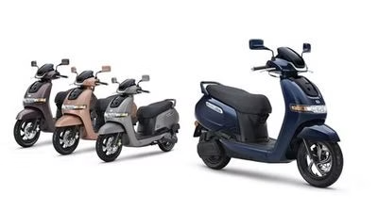

RentRide: Your Ride, Your Way
RentRide provides a hassle-free way to access the vehicles you need, whenever and wherever you need them. With a diverse fleet of cars, trucks, and vans and bikes we have the perfect ride to suit your lifestyle and transportation needs.
Notes:
2

Slide 3


About RentRide
1
Customer-Centric
2
Convenience
At RentRide, we put your needs first. Our team is dedicated to providing personalized service and ensuring your rental experience is seamless.
Rent vehicles with ease through our user-friendly online platform or conveniently located branches. We make it simple to get the ride you want, when you want it.
3
Reliability
Our well-maintained fleet of vehicles is ready to get you where you need to go. You can trust RentRide to deliver dependable transportation for all your adventures.
Notes:
3

Slide 4

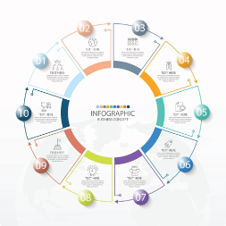
How RentRide Works
Search
Drive
Browse our extensive selection of vehicles and find the perfect one for your needs.
Pick up your vehicle at your chosen location and enjoy the freedom of the open road.
1
2
3
Reserve
Easily book your rental online through our web site, securing your vehicle for your desired dates.
Notes:
4

Slide 5
Our Fleet of Vehicles
Cars
Trucks
Vans
From compact sedans to spacious SUVs, our car selection caters to a variety of driving needs and group sizes.
For those who need to haul larger items or tackle tough terrain, our reliable truck rentals are up for the job.
Our versatile van options are perfect for moving, road trips, or transporting groups of family and friends.
Notes:
5

Slide 6





Rent with Ease
Flexible Booking
Reserve your vehicle for as little as a few hours or as long as a few weeks.
Convenient Locations
Pick up and drop off your rental at any of our strategically placed branches.
24/7 Support
Our friendly customer service team is available around the clock to assist you.
Notes:
6

Slide 7


Reliable and Affordable
Meticulously Maintained
Competitive Rates
We offer transparent pricing and various package options to fit your budget and travel needs.
Our vehicles undergo thorough inspections and regular servicing to ensure a safe and smooth ride.
Peace of Mind
Eco-Friendly Options
Enjoy the confidence of renting from a reputable provider with comprehensive insurance coverage.
Explore our selection of hybrid and electric vehicles to minimize your environmental impact.
Notes:
7

Slide 8
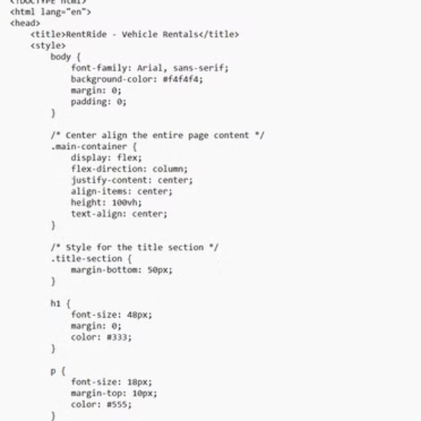
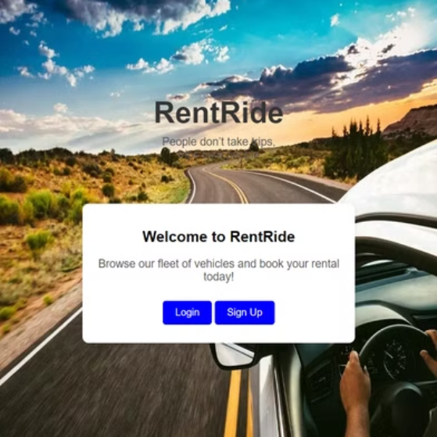
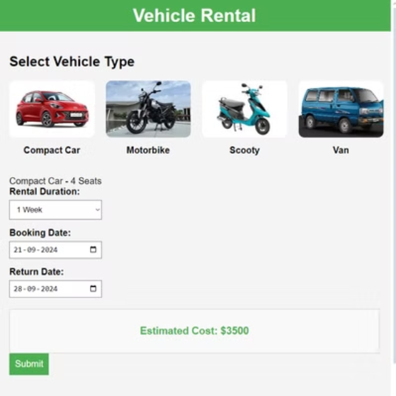
Code and Implementation
Notes:
8

Slide 9
Conclusion
1
Your Ride, Your Way
2
Explore the World
3
Join the Movement
RentRide is your one-stop-shop for all your transportation needs, offering a seamless and personalized rental experience.
Whether you're planning a road trip, a business trip, or a family getaway, RentRide has the perfect vehicle to get you there.
Experience the convenience, reliability, and affordability that RentRide provides. Start your journey with us today!
Notes:
9

Slide 10


